Slide 1
Fracture Roughness – 600 grit Normal Stress & Pore Pressure Oscillations
Experiments conducted: 30/12/2021 – 05/01/2022
Successful Experiments: p5607, p5608
Operator: C. Wood

Slide 2
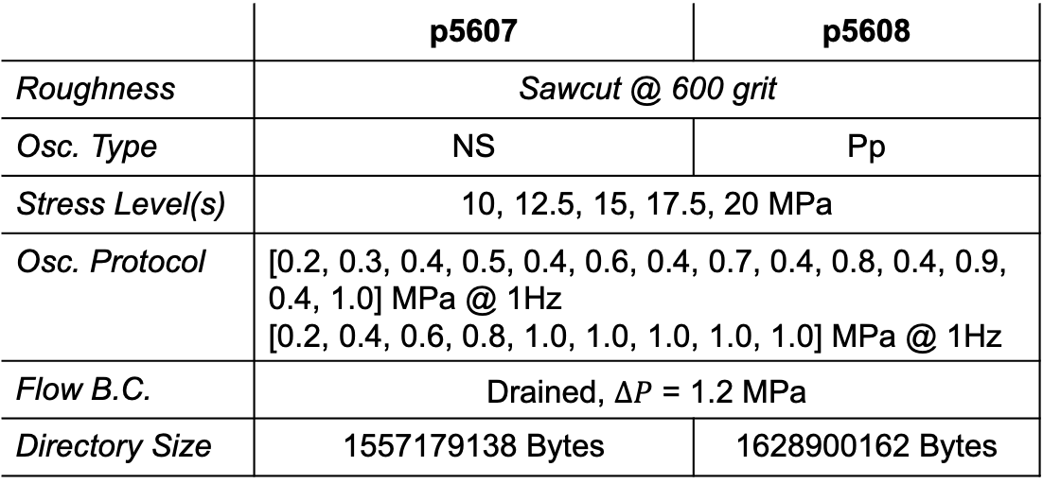
Experiments p5607 & p5608 – A quick look
Receivers
Transmitters
 | p5607 | p5608
Roughness | Sawcut @ 600 grit
Osc. Type | NS | Pp
Stress Level(s) | 10, 12.5, 15, 17.5, 20 MPa
Osc. Protocol | [0.2, 0.3, 0.4, 0.5, 0.4, 0.6, 0.4, 0.7, 0.4, 0.8, 0.4, 0.9, 0.4, 1.0] MPa @ 1Hz [0.2, 0.4, 0.6, 0.8, 1.0, 1.0, 1.0, 1.0, 1.0] MPa @ 1Hz
Flow B.C. | Drained, $∆P$ = 1.2 MPa
Directory Size | 1557179138 Bytes | 1628900162 Bytes
Excitation freq: 0.5 MHz
Time b/w pulses: 0.2 ms
Recording freq: 25 MHz

Slide 3
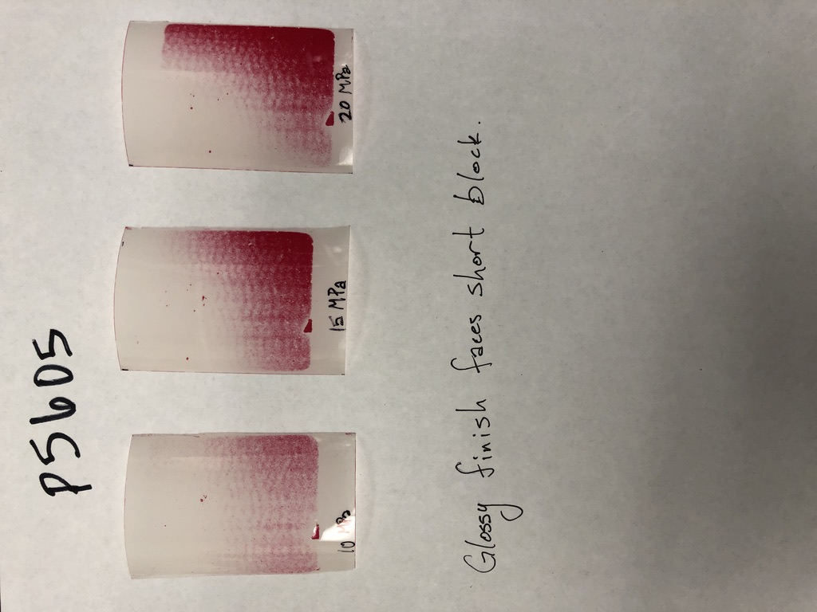
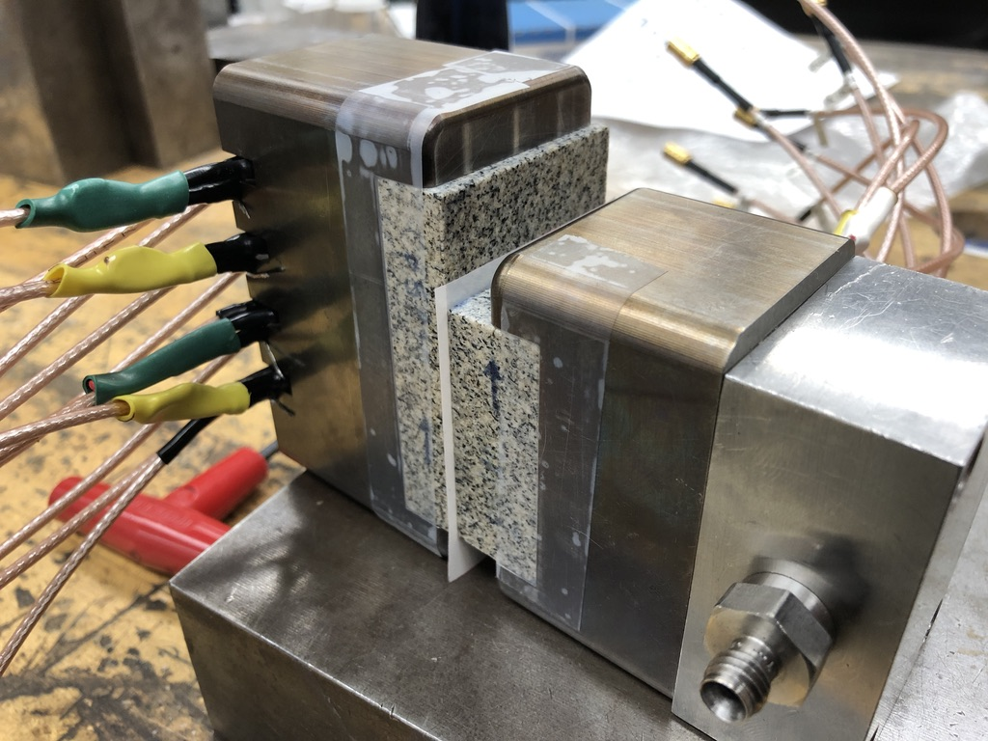
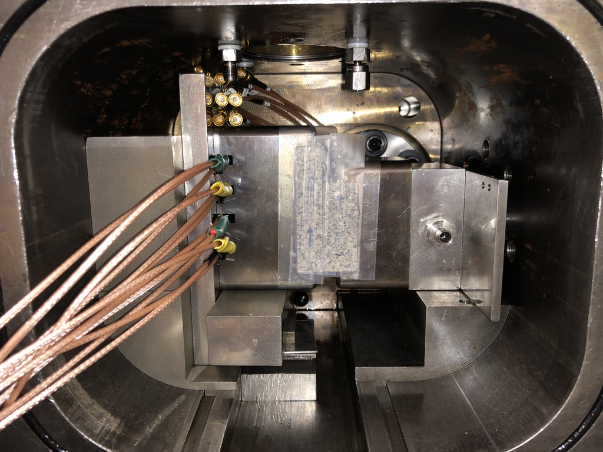
p5605 – pressure sensitive film
Follow-up with pressure films in vertical configuration outside vessel

Slide 4
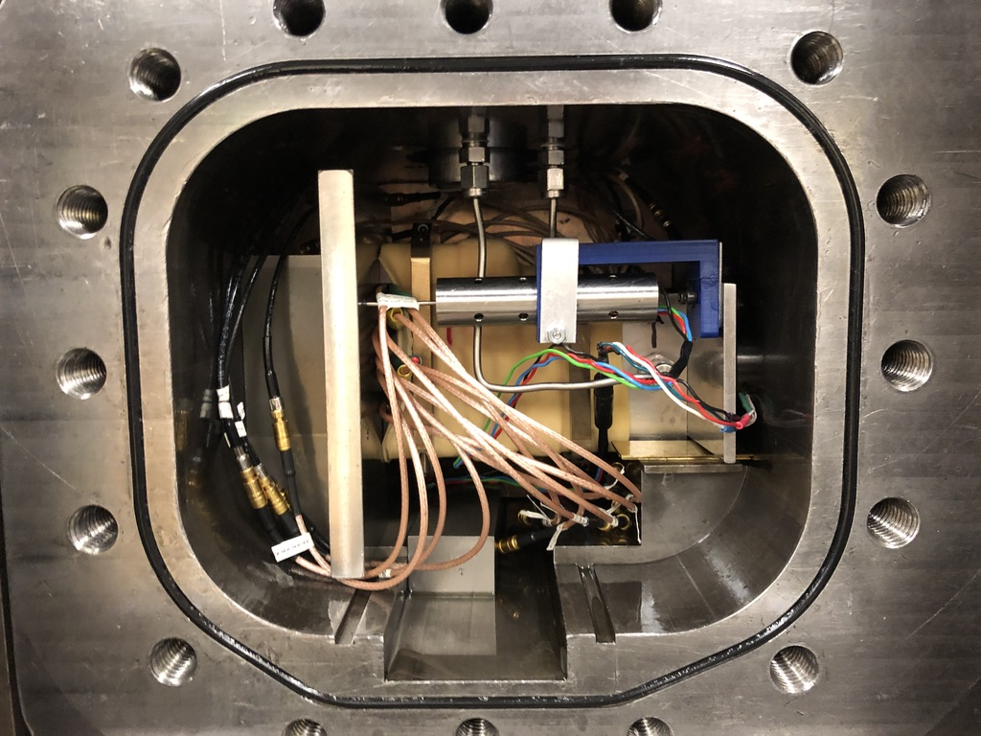
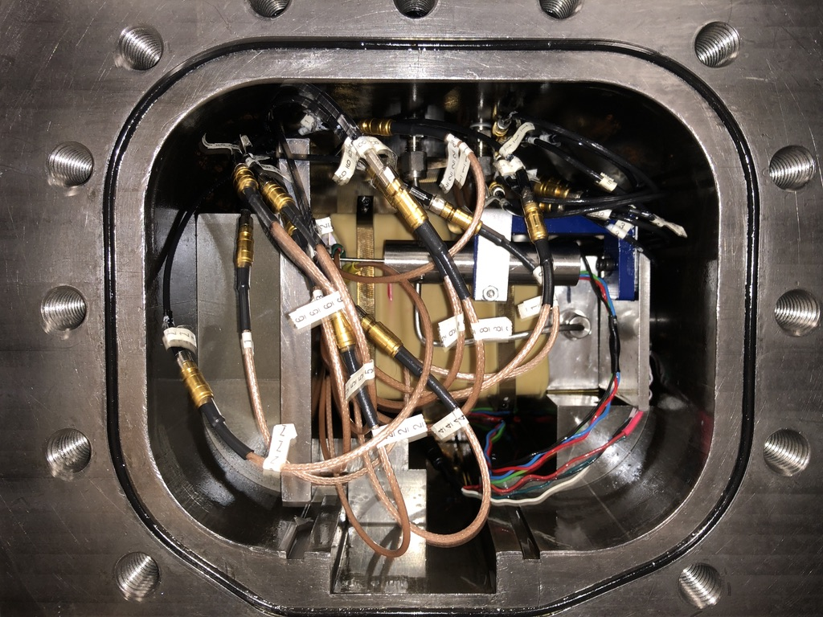
p5607/8 – sawcut fracture @ 600 grit

Slide 5
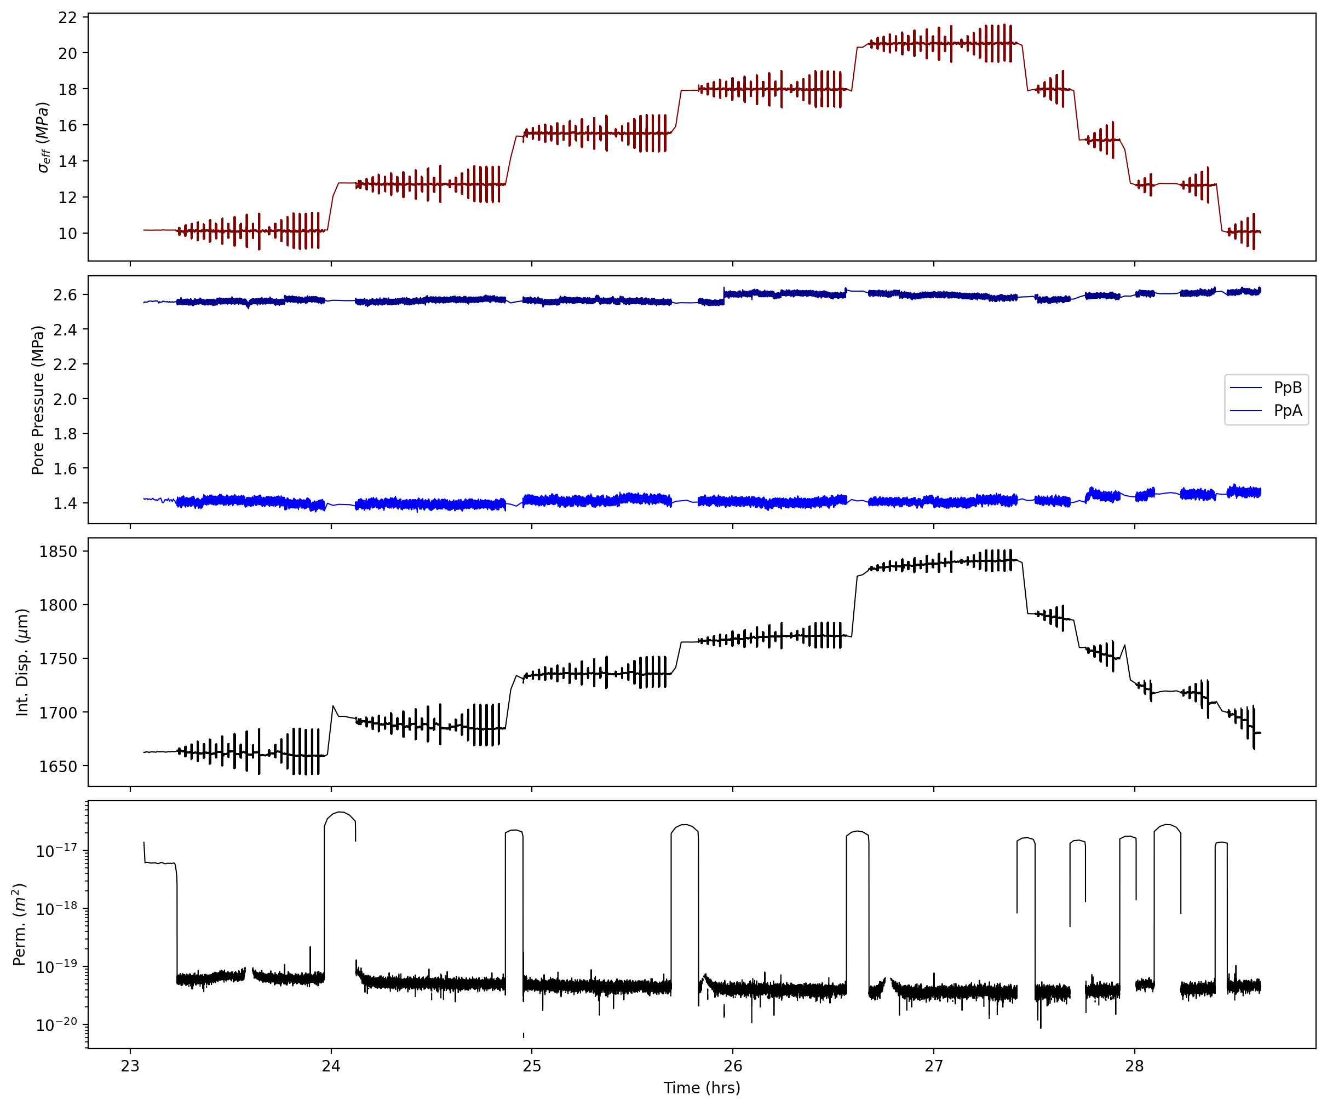
p5607

Slide 6
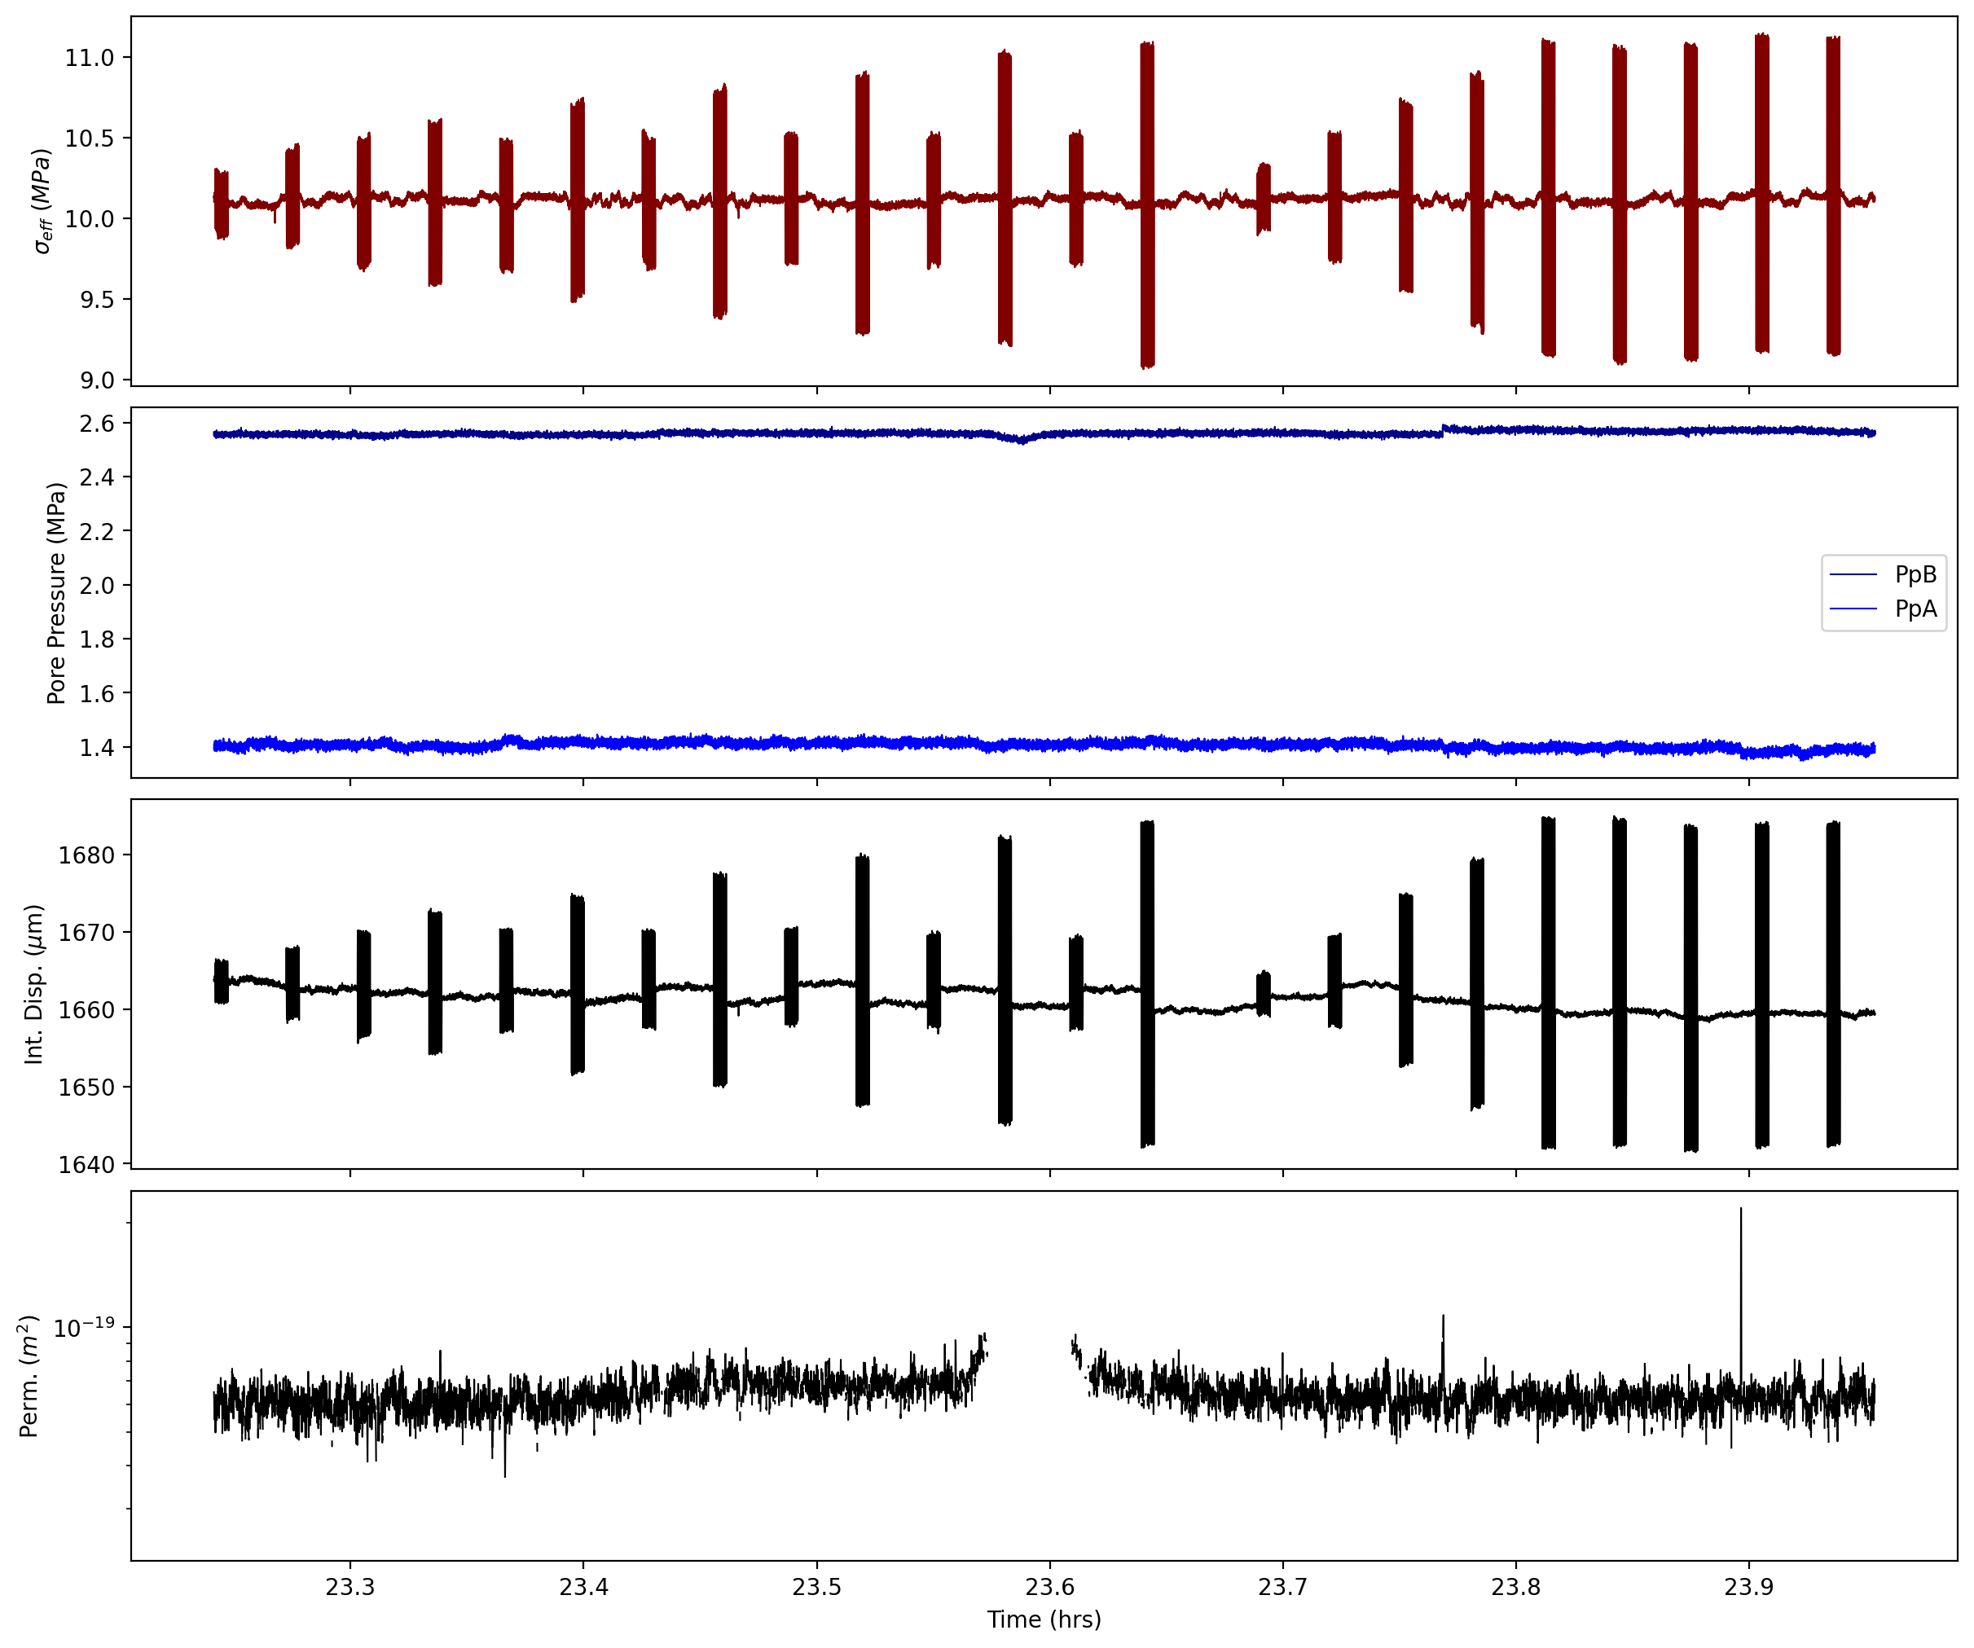
p5607

Slide 7
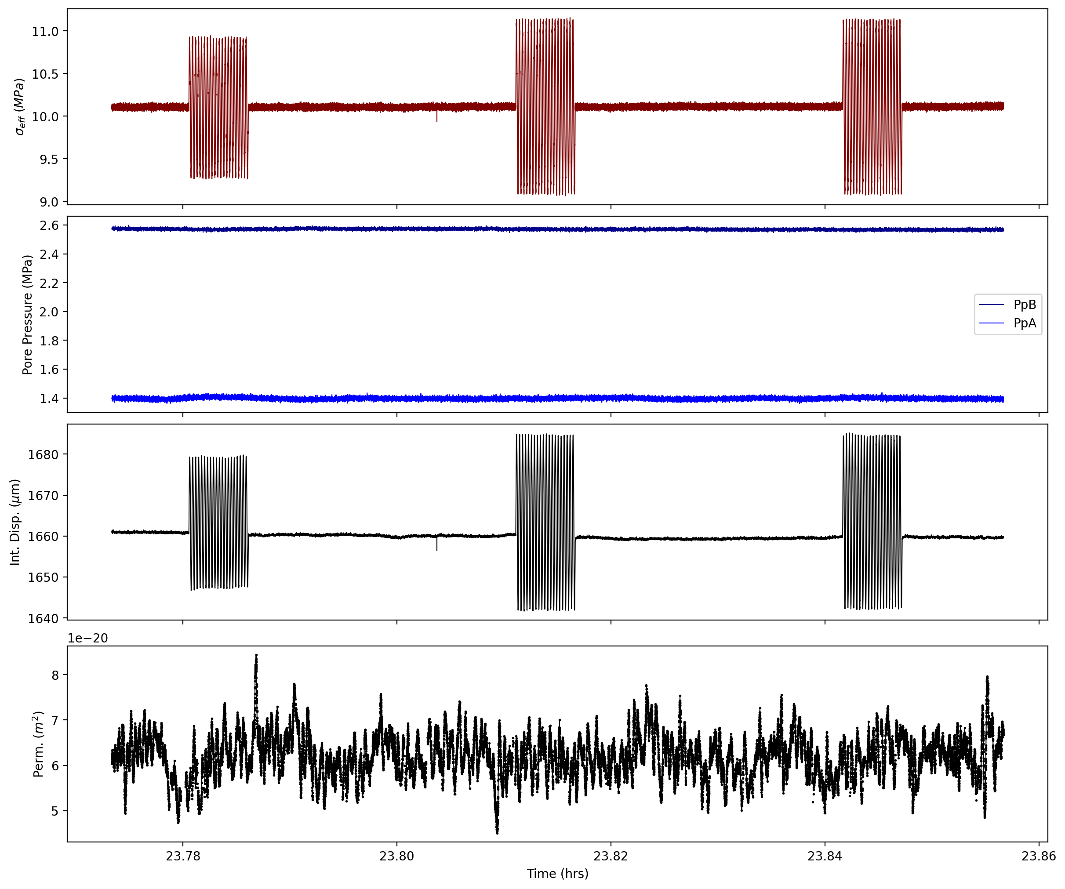
p5607

Slide 8
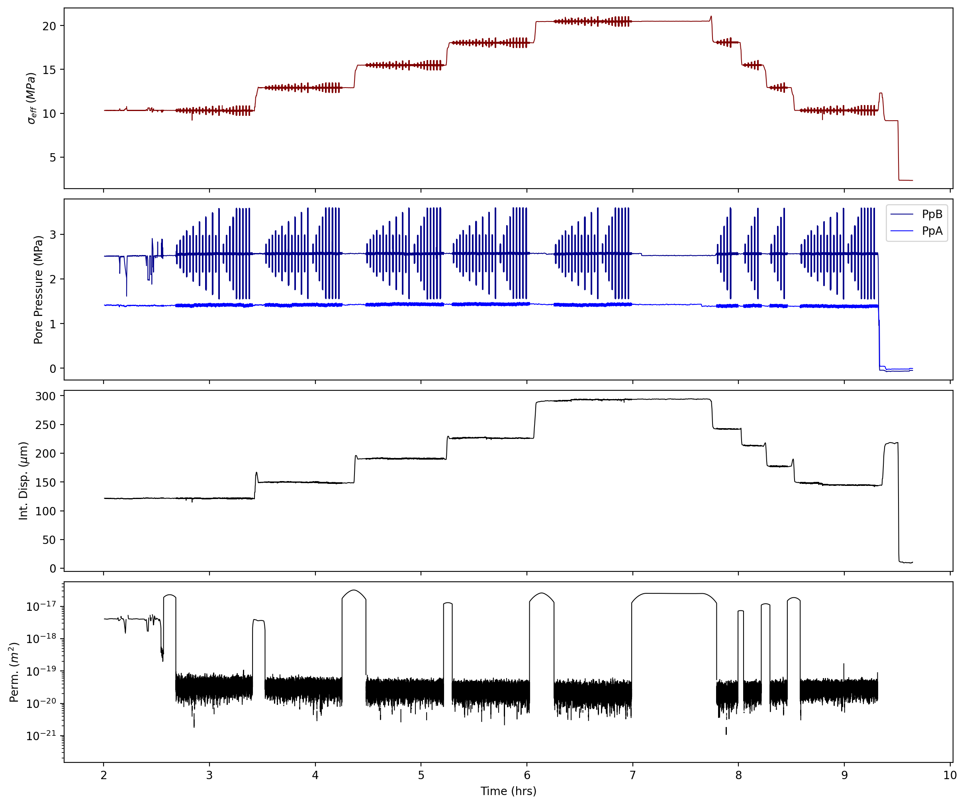
p5608

Slide 9
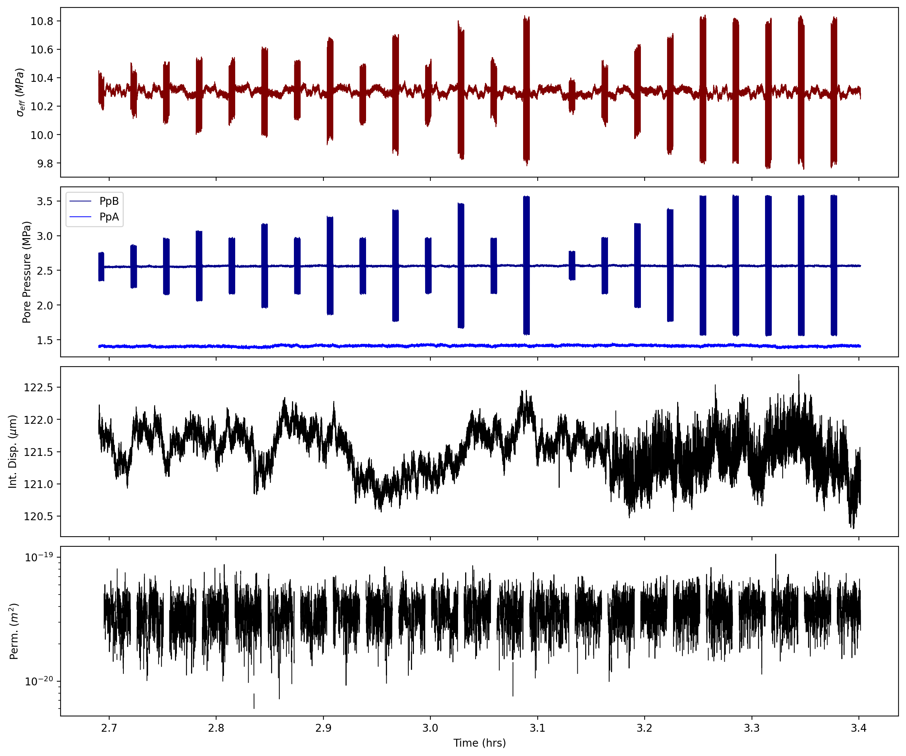
p5608

Slide 10
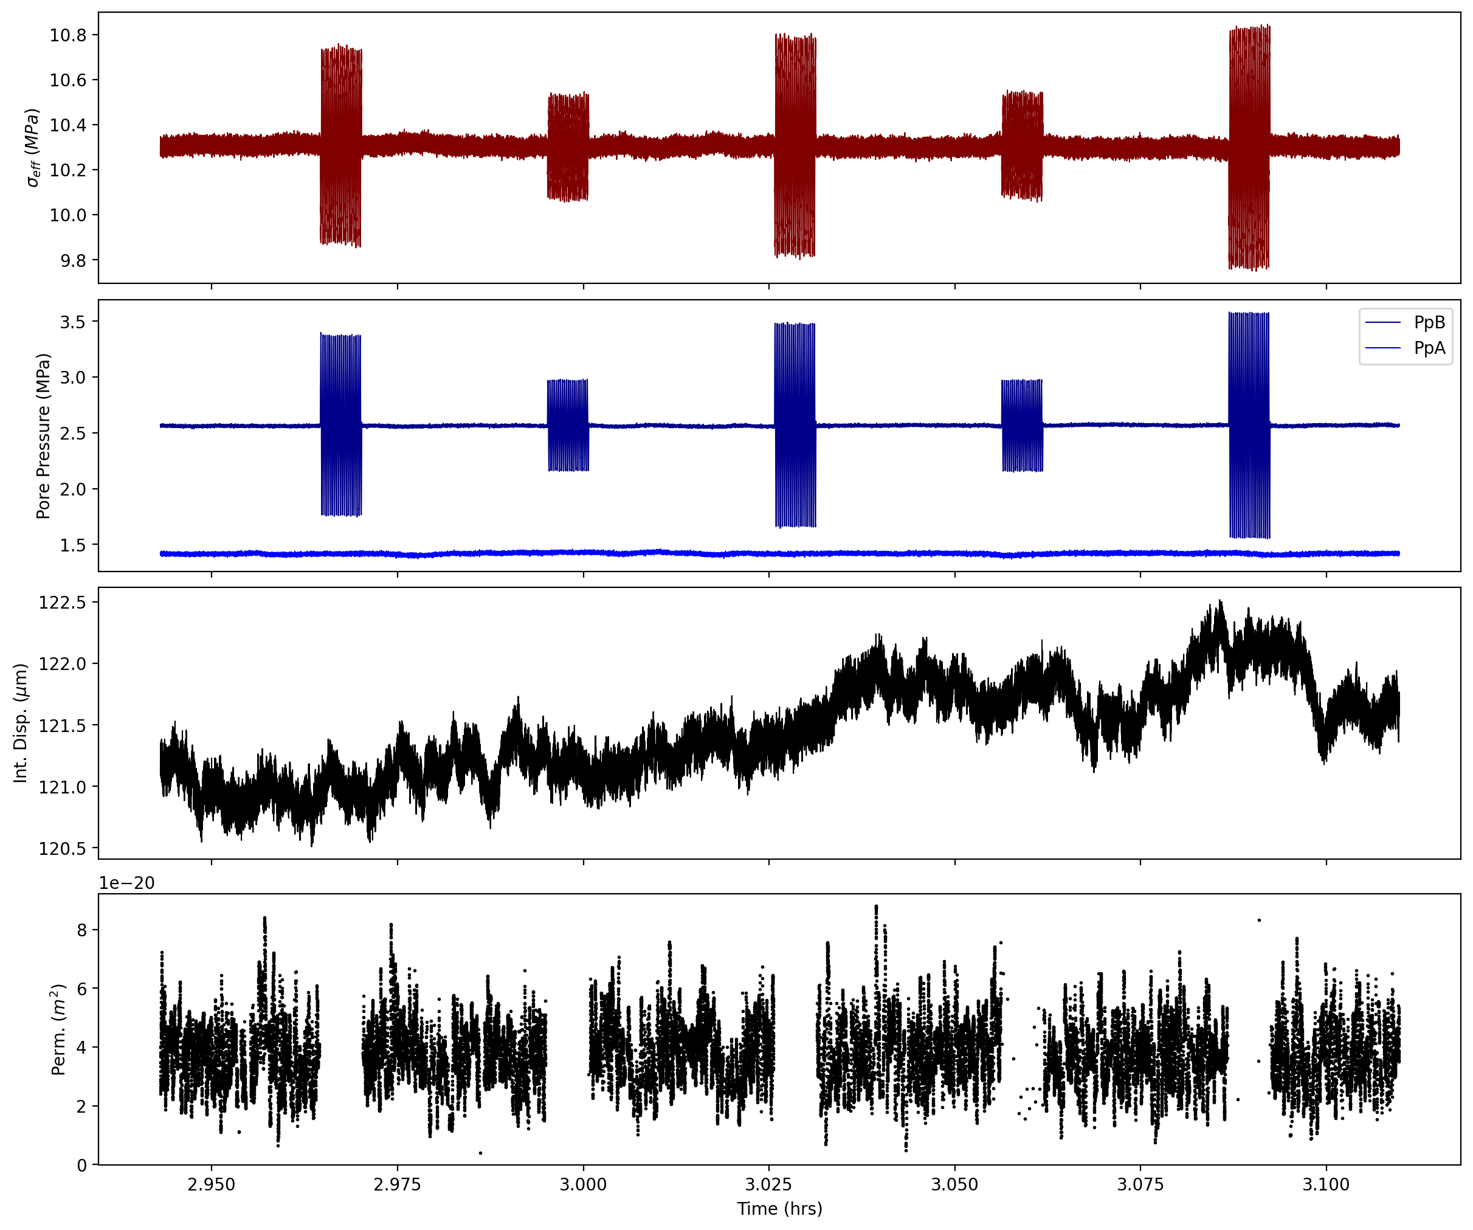
p5608

Slide 11
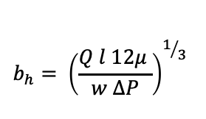
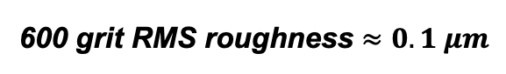
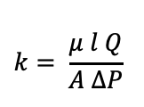
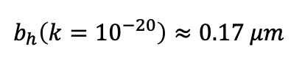
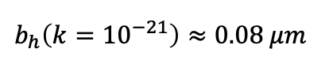
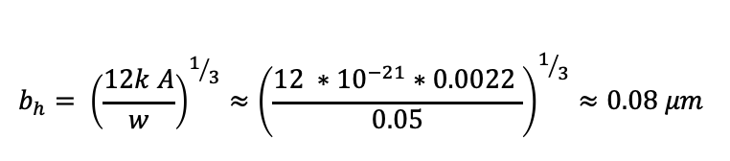
Sanity check
$$k= \frac{μ l Q}{A ΔP}$$
$$b_{h}= {\left(\frac{Q l 12μ }{w ΔP}\right)}^{1/3}$$
$$b_{h}= {\left(\frac{12k A}{w}\right)}^{1/3}≈{\left(\frac{{12 ∗10}^{−21}∗0.0022 }{0.05}\right)}^{1/3}≈0.08 μm$$
$$b_{h}\left(k{=10}^{−21}\right)≈0.08 μm$$
Trans-Tek 244 DCDT
HG Calibration: 0.62 mm/V
Noise Level ~ 1 mV ~ 0.62 um
$$b_{h}\left(k{=10}^{−20}\right)≈0.17 μm$$
600 grit RMS roughness $≈$ $0.1 μm$

Slide 12
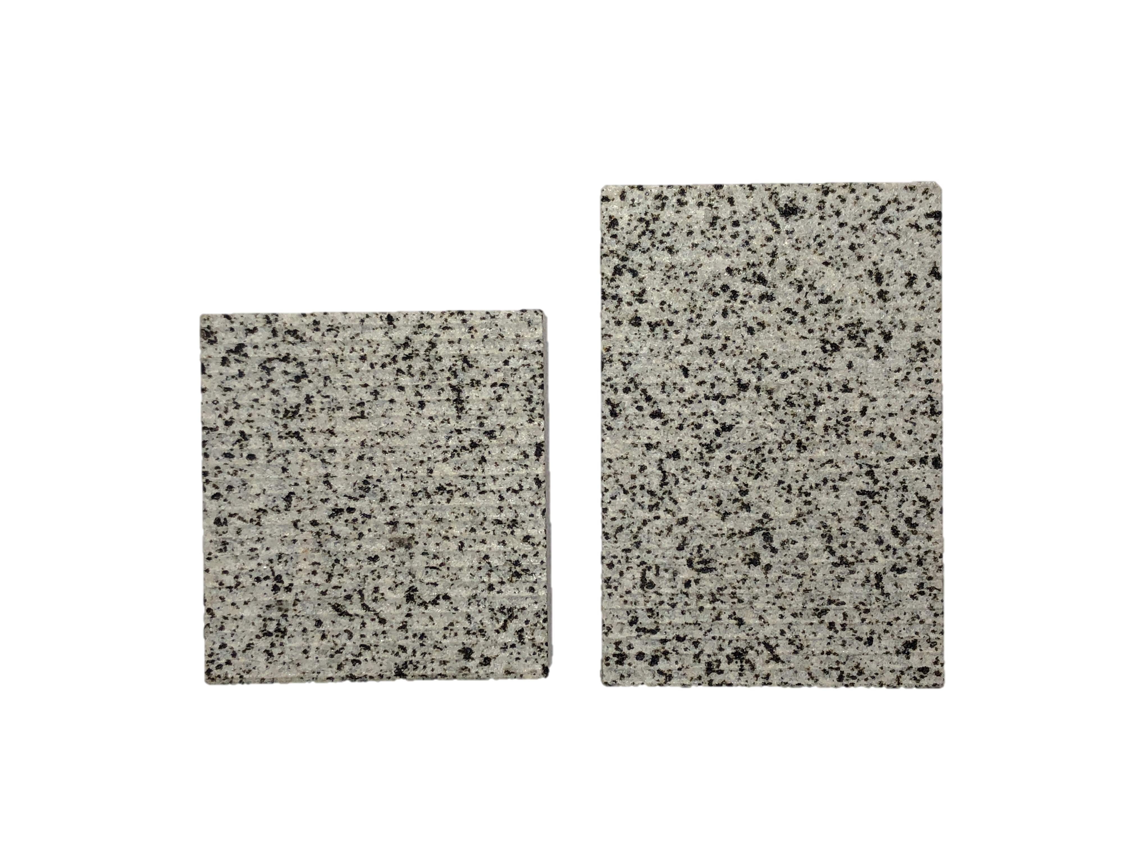
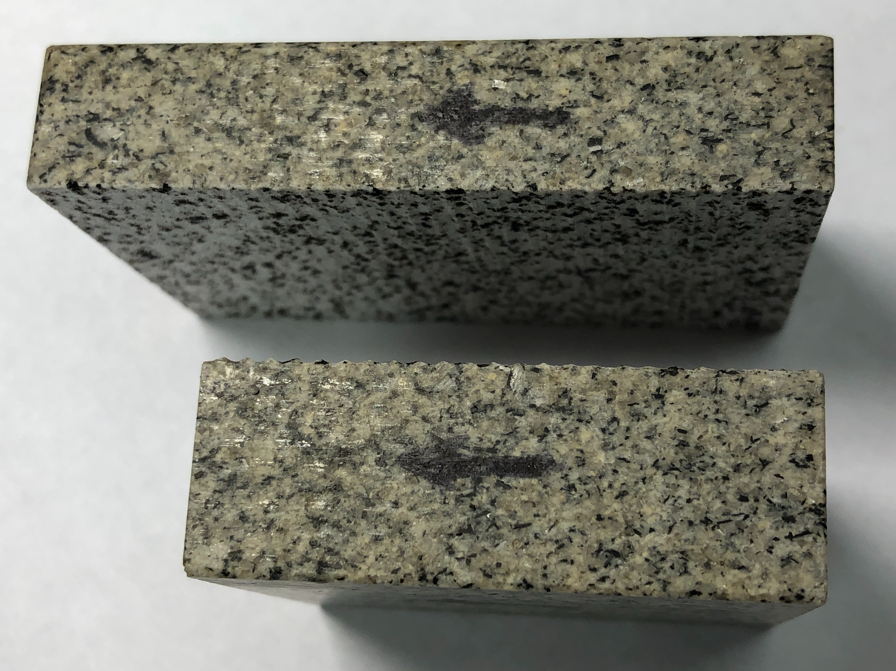
Corrugated Fracture (small & large amp roughness)
Large amplitude roughness: 0.5 mm, λ=1 mm
Small amplitude roughness: ~50 um

